Slide 1
Speed vs. Time Graphs
Introduction

Slide 2
Learning Objectives
I can recognize acceleration on a speed vs. time graph.
I can recognize speed on a speed vs. time graphs.
I can analyze motion on a speed vs. time graphs.
I can calculate slope (acceleration) on a speed vs. time graph

Slide 3
On your paper, Label graph axes as shown
What type of graph is this? Explain why.
S
t

Slide 4

This is a acceleration graph because it shows a change in speed over time (a = s/t).
  The slope of the line on the graph will equal the acceleration. SLOPE = acceleration (higher slope = higher acceleration)
$$slope= \frac{rise}{run}= \frac{Speed}{time}=acceleration$$
S
t

Slide 5
What would a graph showing an object moving at a constant acceleration look like? Try to draw it.
S
t

Slide 6
Constant acceleration
S
t

Slide 7
Now, on the same graph, use a dashed line to show a second object with a SLOWER constant acceleration.
2 constant speeds, one faster, one slower
S
t

Slide 8
Try drawing an acceleration graph that shows an object where the acceleration increases.
S
t

Slide 9
Try drawing an acceleration graph that shows an object where the acceleration decreases.
S
t

Slide 10
Try drawing an acceleration graph that shows an object that has constant deceleration.
S
t

Slide 11
Try drawing an acceleration graph that shows an object where the deceleration decreases.
S
t

Slide 12
Try drawing a acceleration graph that shows an object where the deceleration increases.
S
t

Slide 13
Try drawing an acceleration graph that shows no acceleration.
S
t

Slide 14
Try drawing an acceleration graph that shows an object that travels at a constant acceleration, then acceleration decreases, then has no acceleration?
S
t

Slide 15
accelerates slower
no acceleration
constant acceleration
S
t

Slide 16
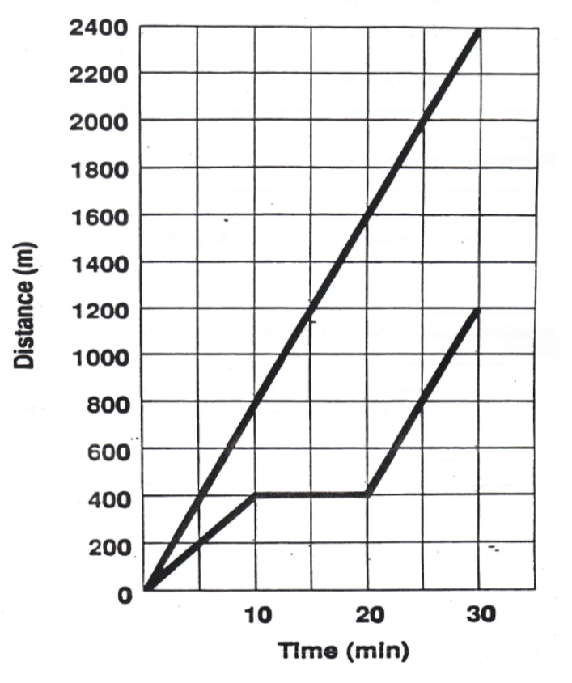


Find the acceleration/slope for A
Slope = $\frac{rise}{run}$ = $\frac{speed}{time}$ = $\frac{y2− y1}{X2 − X1}$ = acceleration
Y₂ =
2400m/min
A
$\frac{Rise}{Run}=\frac{y2− y1}{X2 − X1}$ =
2400m/min -
0m/min
=
15min -
0min
Speed m/min
B
2400m/min
= 160m/min/min
15min
X₂ =
15min
Y₁ =
0m/min
X₁ =
0min

Slide 17
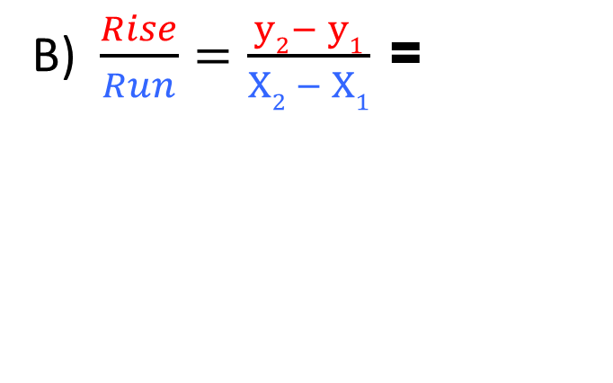

Find the acceleration/slope for B
Slope = $\frac{rise}{run}$ = $\frac{speed}{time}$ = $\frac{y2− y1}{X2 − X1}$ = acceleration
A
B) $\frac{Rise}{Run}=\frac{y2− y1}{X2 − X1}$ =
0m/min
400m/min -
=
20min -
0min
Speed m/min
400m/min
= 20m/min/min
B
20min
400m/min
Y₂ =
Y₁ =
0m/min
X₁ =
0min
X₂ =
20min

Slide 18
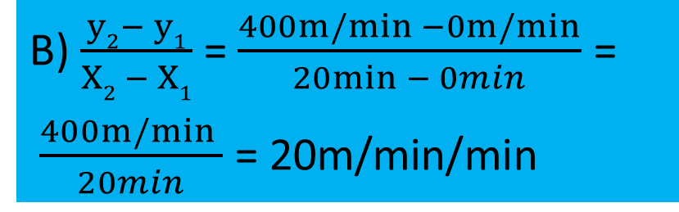
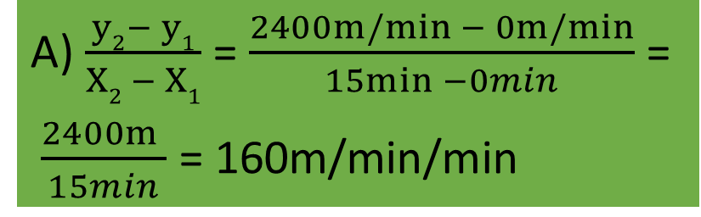
All the accelerations
Slope = $\frac{rise}{run}$ = $\frac{speed}{time}$ = $\frac{y2− y1}{X2 − X1}$ = acceleration
A) $\frac{y2− y1}{X2 − X1}$ = $\frac{2400m/min − 0m/min}{15min −0min}$ =
$\frac{2400m }{15min}$ = 160m/min/min
A
Speed m/min
B) $\frac{y2− y1}{X2 − X1}$ = $\frac{400m/min −0m/min}{20min − 0min}$ =
$\frac{400m/min }{20min}$ = 20m/min/min
B

Slide 19
Big Ideas
The slope on a speed vs. time graph represents ACCELERATION.
A flat line on a speed vs. time graph means you are not accelerating. (Moving at a constant speed)

